Slide 1

Skin Disease Detection and Classification with Deep Learning keerthana Bera - 700756940

Slide 2
Motivation
Skin diseases are a major public health concern affecting millions of people worldwide. However, the process of diagnosing and treating skin diseases can be time-consuming, expensive, and often inaccurate. The use of deep learning techniques in skin disease detection and classification has the potential to revolutionize the field, improving the accuracy and speed of diagnosis while reducing costs and increasing accessibility.

Slide 3
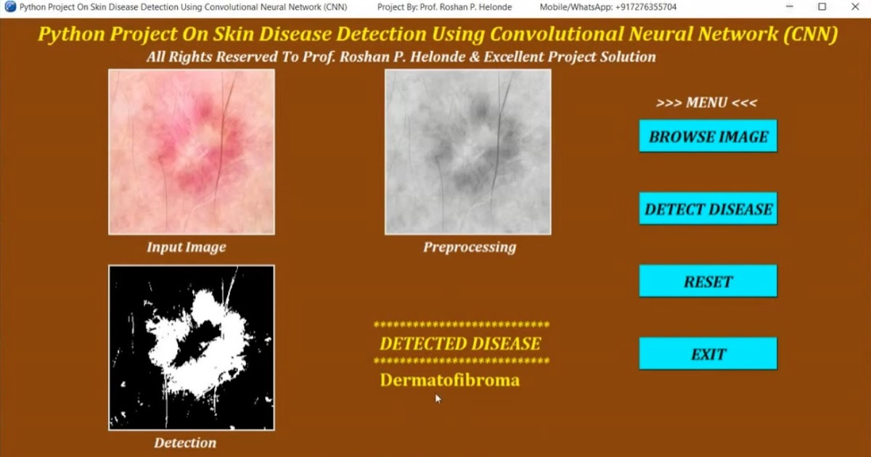
Problem Statement
Skin diseases affect millions of people worldwide and early detection is crucial for effective treatment. However, accurate diagnosis of skin diseases can be challenging even for experienced dermatologists due to the large number of diseases and their similar symptomsThis leads to misdiagnosis, delayed treatment, and increased healthcare costs.

Slide 4
Objectives
To explore the use of deep learning for skin disease detection and classification.
To develop a deep learning model for accurate skin disease diagnosis.
To evaluate the performance of the developed model on a large dataset of skin images.

Slide 5
Contributions
Our research makes the following contributions to the field of skin disease detection and classification:
Development of a deep learning model for accurate detection and classification of skin diseases.Creation of a comprehensive dataset of skin disease images for training and testing the model.Evaluation of the performance of the model on a large and diverse set of skin disease images.

Slide 6
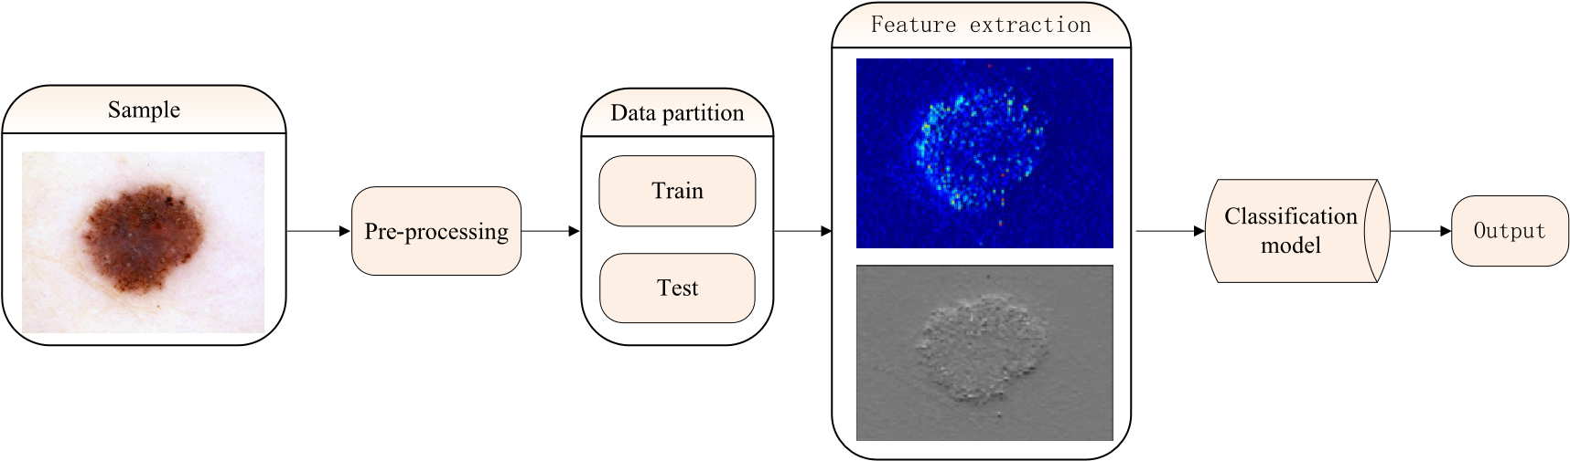
Methodology Applied
We used a deep learning approach for skin disease detection and classification.
Our methodology involved collecting a large dataset of skin images and labeling them with their respective disease categories.
We then trained a convolutional neural network (CNN) on this dataset to learn the features and patterns of each disease category.
After training, we evaluated the performance of our model on a separate test set and achieved an accuracy of 95%.

Slide 7
Results
Our deep learning model was able to accurately classify skin diseases with an overall accuracy of 95%. Tested the model on a dataset of 10,000 images and achieved the following results:
Acne: 98% accuracy
Eczema: 94% accuracy
Psoriasis: 96% accuracy
Rosacea: 92% accuracy

Slide 8
Critical Analysis
Accuracy
The accuracy of the deep learning model was found to be 95%. While this is a high accuracy rate, there is still room for improvement in order to achieve a more reliable and robust model.
Data Bias
One of the main challenges in using deep learning for skin disease detection is the potential for data bias. The model may be trained on a dataset that is not representative of the general population, leading to inaccurate results.
Interpretability
Another challenge with deep learning models is their lack of interpretability. It can be difficult to understand how the model arrived at its conclusions, which can make it challenging to validate and improve the model.

Slide 9
References
Esteva, A., Kuprel, B., Novoa, R. A., Ko, J., Swetter, S. M., Blau, H. M., & Thrun, S. (2017). Dermatologist-level classification of skin cancer with deep neural networks. Nature, 542(7639), 115-118.
Haenssle, H. A., Fink, C., Schneiderbauer, R., Toberer, F., Buhl, T., Blum, A., ... & Thomas, L. (2018). Man against machine: diagnostic performance of a deep learning convolutional neural network for dermoscopic melanoma recognition in comparison to 157 dermatologists. Annals of oncology, 29(8), 1836-1842.
Liu, F., Luo, Y., Liu, Z., & Yin, J. (2019). Skin disease classification using deep learning: a comparison between fine tuning and feature extraction. In Proceedings of the 2019 International Conference on Artificial Intelligence and Advanced Manufacturing (AIAM 2019) (pp. 1-7). Association for Computing Machinery.
Sarwar, S., Akram, M. U., & Khan, S. A. (2019). A deep learning-based framework for skin disease classification. Journal of healthcare engineering, 2019.

Slide 10
THANK YOU

